Slide 1
The Past, Present and Future of Mobile Technologies
Richard Ansell

Slide 2
Synopsis
A brief overview of the past, present and future of mobile technologies and how they have evolved over the years
Look back at the very first mobile device launched to market, showing where mobile technology first began
Overview of the operating systems over the years and how they have evolved, including market share data showing the leaders
A look at the present day and more importantly the key players involved in bringing the latest mobile technologies to the market
Prediction of the future of mobile that discusses some of the very latest technologies being developed over the next ten years and how they are drastically changing the perception of mobile devices

Slide 3
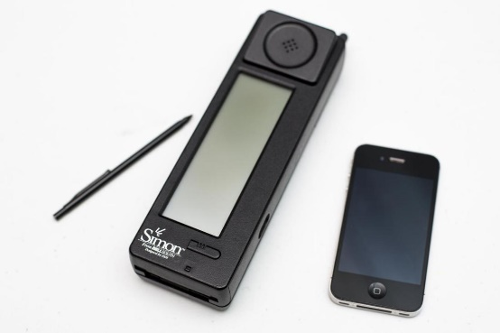
Past – History of Mobile
First working mobile phone invented in 1973 by Martin Cooper whilst working for Motorola (Every-One Is Wrong, 2001)
Paved the way for mobile operating systems to be created
IBM Simon was the first touch screen smartphone to be launched in 1994, as shown in Figure 1 below (Microsoft Research)
The Ericsson R380 became one of the first smartphones to run on the Symbian operating system (McCarty, 2011)
Figure 1
(Aamoth, 2015)

Slide 4
Past – Operating Systems Timeline
Major operating systems for smartphones have changed over the past 22 years, as follows:
  Windows CE (1999) (Figure 2)
  Symbian (2000) (Figure 3)
  Blackberry (2002) (Figure 4)
  Palm Web OS (2002) (Figure 5)
  Apple iOS (2007) (Figure 6)
  Android (2008) (Figure 7)
  Windows Phone (2010) (Figure 8)
  MeeGo (2010) (Figure 9)
  Firefox OS (2013) (Figure 10)
iOS followed by Android have since become the established market leaders (Froehlich, 2015)

Slide 5



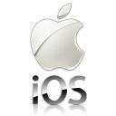



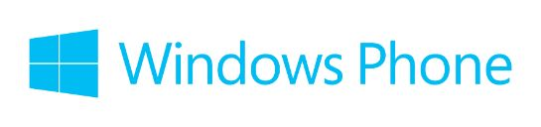

Past – Operating Systems
Figure 2
Figure 3
Figure 4
(Wikipedia, 2015)
(Wikipedia, 2012)
(Kari, 2013)
Figure 6
Figure 7
Figure 5
(Wikimedia Commons, 2015)
(Greater Cayce West Columbia Chamber of Commerce, n.d.)
(Maguzz, 2015)
Figure 10
Figure 8
Figure 9
(Geary, 2015)
(Wikimedia Commons, 2014)
(Mozilla, n.d.)

Slide 6
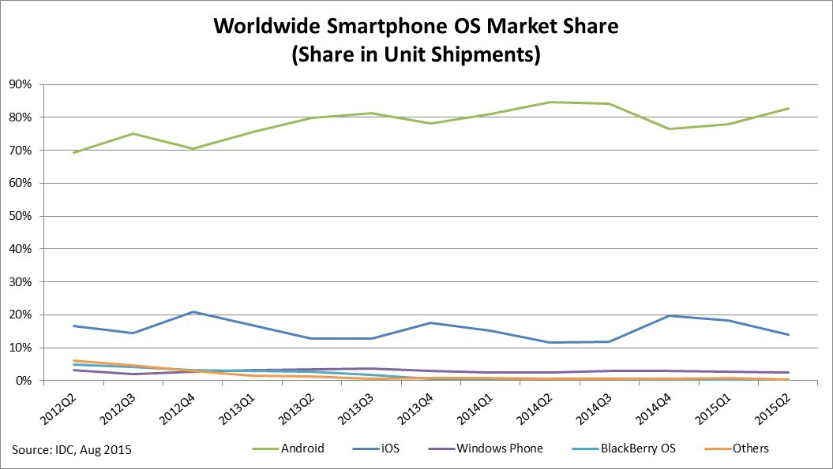
Past – Operating Systems Market Share
Android dominate the market share of smartphone units shipped followed some distance by Apple iOS from 2012 up until the second quarter of 2015, as shown in Figure 11 below
Figure 11
(IDC Research, 2015)

Slide 7
Past – Apple iOS
The Apple iPhone packaged with iOS 1 was launched in 2007 with further key updates to integrate with iTunes Music Store
Subsequent versions up to iOS 8 included features such as QuickType, which have further extended the success of the Apple iPhone and its core operating system (Williams, 2015)
Despite launching prior to Android, Apple’s iOS market share for units sold is eclipsed by Android

Slide 8
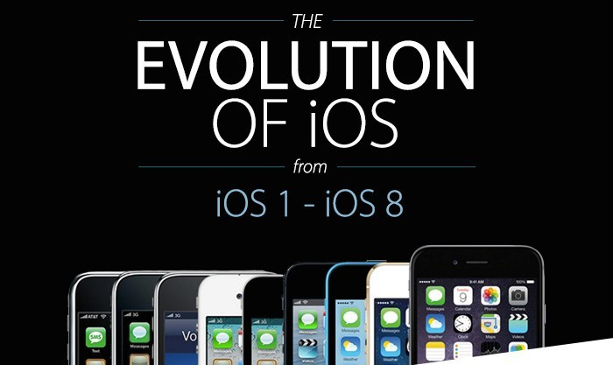
Past – Apple iOS Version History
The Apple operating system (iOS) has evolved significantly over the years from iOS 1 to iOS 8, as shown in Figure 12 below
Figure 12
(Green, 2014)

Slide 9
Past – Android
Version 1.0 began with the very first Android operating system to be launched in 2008 on the T-Mobile G1, featuring access to apps via the Android Market (The Verge, 2011)
The Android operating system received a major overhaul in version 1.5 (Cupcake), including support for Bluetooth and a smartphone’s camcorder
Major manufacturers including HTC and Samsung then began shipping their handsets with the Cupcake operating system
Later Android versions spanning from 1.5 Cupcake to 5.0 Lollipop have since been released, from major design improvements of the user interface to ground-breaking new features including Google Now (Hildenbrand, 2013)

Slide 10
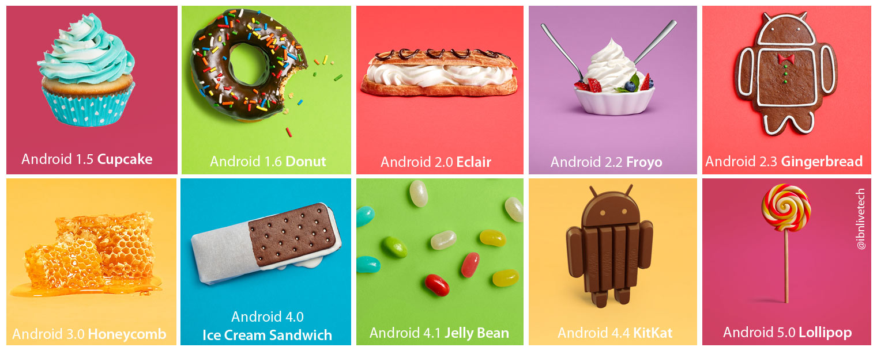
Past – Android Version History
Android versions have each been given a unique and somewhat catchy code name since version 1.5 Cupcake , as shown in Figure 13 below
Figure 13
(IBN Live, 2014)

Slide 11
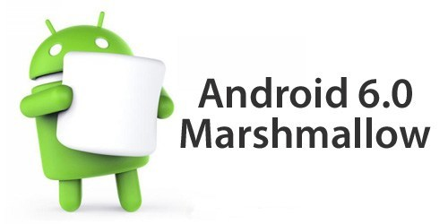
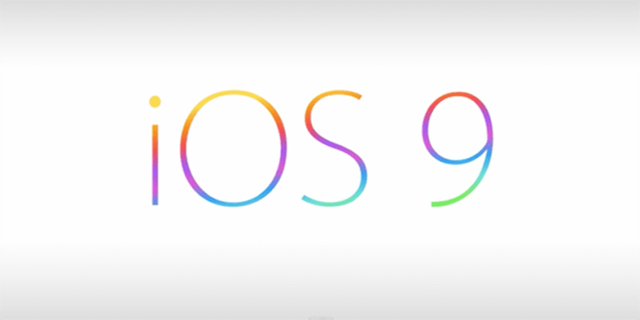
Present
The launch of Android 6.0 Marshmallow (Figure 14) continues the success of Android with new features including Now on Tap and Doze for readily accessible information and extended battery life (Google)
Apple launch iOS 9 (Figure 15) featuring personalised content delivery in their News app and Split View to allow users to use two apps at once on an iPad (What’s new in iOS., 2015)
Figure 14
(Agarwal, 2015)
Figure 15
(Yalburgi, 2015)

Slide 12
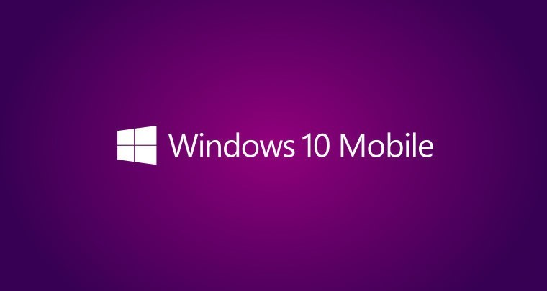
Present
Microsoft launch Windows 10 Mobile (Figure 16) for their Lumia range, including improved features across their operating system (Windows 10. Do great things., 2015)
Still to be seen if Windows can seriously challenge Android and Apple to gain market share...
Figure 16
(Ali, 2015)

Slide 13
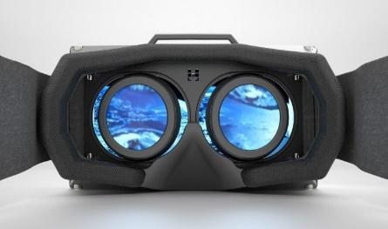
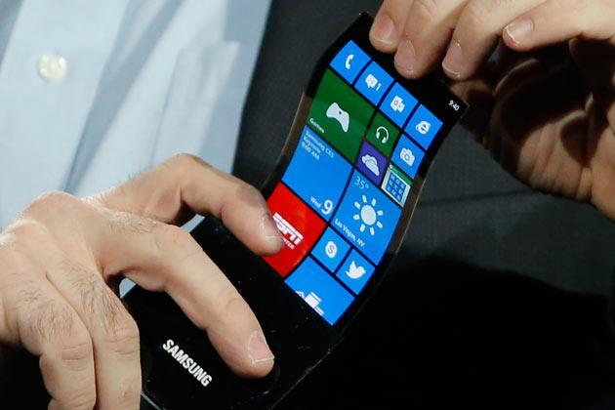
Future
The future of mobile technologies is uncertain, yet key technological advancements are already in development across wide ranging areas
Next year
The anticipated launch of the virtual-reality headset Oculus Rift, shown in Figure 17 below is due to officially be unveiled in the first quarter of 2016 (Egan, 2015)
The release of a flexible screen by smartphone manufacturer Samsung is also due to launch in January 2016, as shown in Figure 18 below (Eadicicco, 2015)
Figure 17
Figure 18
(Edwards, 2015)
(Agomuoh, 2015)

Slide 14
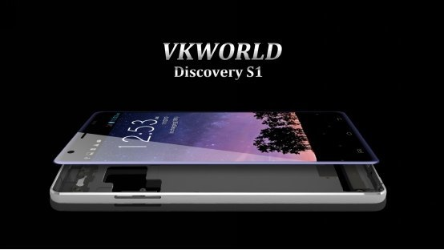
Future
5 years
The launch of the worlds first high definition glasses-free 3D smartphone known as the VKWorld Discovery S1, shown in Figure 19 below (Edwards, 2015)
10 years
The launch of high-speed 5G connection is already in the early stages of development and is assumed to be available on a wide scale by 2025 (Ripton, 2014)
Figure 19
(Ali, 2015)

Slide 15
Conclusion
Mobile technology has witnessed drastic improvements from the very first IBM Simon handset in 1973
Mobile operating systems have similarly changed significantly over the years to allow users to do more with their mobile devices
Android and Apple have became the preferred choice of operating systems for many users, which has seen the demise of many other operating systems as a result
The future is uncertain, yet mobile technology shows clear signs of developing into completely new territory well beyond a simple handset

Slide 16
References
Apple. (2015). What’s new in iOS. Retrieved December 1, 2015, from Apple: http://www.apple.com/uk/ios/whats-new/
Cooper, M. (2001, June 1). Every-One Is Wrong. Technology Review, p. 82. Retrieved December 1, 2015
Eadicicco, L. (2015, September 15). Samsung is reportedly working on a phone with a crazy flexible screen that bends and folds, and it could launch in January. Retrieved December 2, 2015, from Tech Insider: http://www.techinsider.io/samsung-flexible-foldable-phone-vidoes-2015-9
Edwards, L. (2015, August 7). World’s first HD glasses-free 3D smartphone is here, meet VKWorld Discovery S1. Retrieved December 2, 2015, from Pocket-lint: http://www.pocket-lint.com/news/134850-world-s-first-hd-glasses-free-3d-smartphone-is-here-meet-vkworld-discovery-s1

Slide 17
References
Egan, M. (2015, September 24). Oculus Rift UK release date, specs, features and game rumours: Tune into today's Oculus Connect 2 keynotes. Retrieved December 2, 2015, from TechAdvisor: http://www.pcadvisor.co.uk/buying-advice/gadget/oculus-rift-release-date-specs-features-hands-on-connect-keynote-3522990/
Froehlich, A. (2015, March 3). Smartphone OS: A 22-Year History. Retrieved December 1, 2015, from InformationWeek: http://www.informationweek.com/mobile/mobile-applications/smartphone-os-a-22-year-history/d/d-id/1319495?
Geary, L. (2015). Gartner reports another slide for Windows Phone. [image] Available at: http://www.coolsmartphone.com/2015/11/19/gartner-reports-another-slide-for-windows-phone/ [Accessed 2 Dec. 2015]
Google. (n.d.). Android 6.0 Marshmallow. Retrieved December 1, 2015, from Android: http://www.android.com/versions/marshmallow-6-0/

Slide 18
References
Greater Cayce West Columbia Chamber of Commerce, (n.d.). Mobile App - Launch Page. [image] Available at: http://www.cwcchamber.com/chamber-mobile-app.html [Accessed 2 Dec. 2015]
Hildenbrand, J. (2013, June 11). Inside the different Android Versions. Retrieved December 1, 2015, from Android Central: http://www.androidcentral.com/android-versions
Kari, K. (2013). Blackberry Logo. [image] Available at: http://rui-sanches.blogspot.co.uk/2013/05/blackberry-logo.html [Accessed 2 Dec. 2015]
Maguzz, (2015). Google Logo PNG Transparent Background. [image] Available at: http://www.maguzz.com/4/google-logo-png-transparent-background.html [Accessed 2 Dec. 2015]

Slide 19
References
McCarty, B. (2011, December 6). The History of the Smartphone. Retrieved December 1, 2015, from The Next Web (TNW): http://thenextweb.com/mobile/2011/12/06/the-history-of-the-smartphone/
Microsoft. (2015). Windows 10. Do great things. Retrieved December 1, 2015, from Microsoft: http://www.microsoft.com/en-gb/mobile/windows10/#
Microsoft Research. (n.d.). Simon. Retrieved December 1, 2015, from Buxton Collection: http://research.microsoft.com/en-us/um/people/bibuxton/buxtoncollection/detail.aspx?id=40
Mozilla, (n.d.). Firefox OS branding. [image] Available at: https://www.mozilla.org/en-US/styleguide/identity/firefoxos/branding/ [Accessed 2 Dec. 2015]

Slide 20
References
Ripton, J. (2014, August 26). The 5G network: when will it launch and what will it mean for consumers? Retrieved December 2, 2015, from The Guardian: http://www.theguardian.com/media-network/media-network-blog/2014/aug/26/5g-network-launch-mobile-consumers-connectivity-download
The Verge. (2011, December 7). Android: A visual history. Retrieved December 1, 2015, from The Verge: http://www.theverge.com/2011/12/7/2585779/android-history
Wikimedia Commons, (2014). File:MeeGo logo.svg. [image] Available at: https://commons.wikimedia.org/wiki/File:MeeGo_logo.svg [Accessed 2 Dec. 2015]
Wikimedia Commons, (2015). File:Palm webOS logo.svg. [image] Available at: https://commons.wikimedia.org/wiki/File:Palm_webOS_logo.svg [Accessed 2 Dec. 2015]

Slide 21
References
Williams, R. (2015, September 17). Apple iOS: a brief history. Retrieved December 1, 2015, from The Telegraph: http://www.telegraph.co.uk/technology/apple/11068420/Apple-iOS-a-brief-history.html
Wikipedia, (2012). File:Symbian logo.svg. [image] Available at: https://en.wikipedia.org/wiki/File:Symbian_logo.svg [Accessed 2 Dec. 2015]
Wikipedia, (2015). File:Windows CE.png. [image] Available at: https://en.wikipedia.org/wiki/File:Windows_CE.png [Accessed 2 Dec. 2015]

Slide 22
Further reading
Heckel, P. (2015, January 24). 2015 Mobile and Emerging Technology Trends and Predictions. Retrieved December 2, 2015, from Solstice Mobile: http://www.solstice-mobile.com/blog/2015-mobile-and-emerging-technology-trends-and-predictions
Rivera, J., & Meulen, R. v. (2014, February 24). Gartner Identifies Top 10 Mobile Technologies and Capabilities for 2015 and 2016. Retrieved December 2, 2015, from Gartner: http://www.gartner.com/newsroom/id/2669915

